Slide 1



BYOP GROUP = D UK TRAFFIC DATASET
Integrated Program in Business Analytics
Project Mentor : Mohd.Syed Ali

Slide 2

Aatish Mathur Process Manager, Amex
Pratik Sharma Sales Officer, AR Enterprise
Shabana Shaikh Equity Advisor, SBICap
Timsy Kapoor Assistant Professor
Akshara S Vijay Developer 1
Aditya Singh Digital Content Producer, TOI
Nandini Agrawal AI Engineer, igebra.ai
IPBA BATCH 14
TOGETHER WE ARE TEAM

Slide 3

Presentation Headway
Introduction to the Data Science Project
Understanding the Data: Data Collection and Exploration
Data Cleaning and Preprocessing
Exploratory Data Analysis (EDA) Techniques
Visualizing Data Patterns and Insights
Feature Engineering and Selection
Conclusion and Next Steps

Slide 4
About Data & It’s Objective
This dataset, pertains to UK traffic and consists of over 1 million records with 34 columns. The dataset includes information about geographic areas, vehicle types, casualty numbers, and the number of local authorities involved.
The objective of this project is to collect precise data that reflects the actual traffic conditions in various areas of the UK. This may involve counting the number of vehicles using a particular road or gathering information on journey times.
The data on the frequency of traffic passing through a specific road section during a certain period is crucial in determining the significance of that road. By analyzing this data, we can gain insights into vehicle behavior and identify the primary causes of accidents that occur.

Slide 5
PROBLEM STATEMENT
The dataset can help answer the following questions:
1. Which days experience the highest number of accidents?
2. How has the nature of car accidents evolved throughout the year?
3. What is the response and behavior of the police when accidents occur? Is it influenced by the severity of the accidents?
4. How has road safety progressed over time?
5. Where do major accidents commonly occur, and what are the primary causes of car crashes?
6. What is the trend in the number of casualties?
7. How are the severity of injuries distributed across the country?
8. Which are the top 20 local authorities with the highest collision rates?
9. On each day of the week, what are the maximum and minimum speed limits on the roads where accidents happen?
10. What is the significance of light and weather conditions in predicting accident severity?
These questions can be addressed using the dataset, enabling a better understanding of road safety and informing strategies for accident prevention and response.

Slide 6
TARGET VARIABLE:
SLIGHT
SERIOUS
FATAL
The target variable in this dataset is "Accident Severity," which classifies accidents into three categories of severity:
The target variable in this dataset is "Accident Severity," which classifies accidents into three categories of severity:

Slide 7
Data Dictionary
Pedistrian_crossing_HumanControl&PhysicalFacilities (STRING)
Road_Surface_Condition (STRING)
Speical_Condition_at_Site
(STRING)
Police Force (STRING)
Accident Severity (STRING)
Did_Police_Officer_Attend_Scene_of_Accident (STRING)
Number_of_Casualities
(NUMERIC)
Carriageway_Hazards
(STRING)
Junction_Control
(STRING)
Data Dictionary
Light and Weather Conditions (STRING)
LSOA_of_Accident_Location
(STRING)

Slide 8
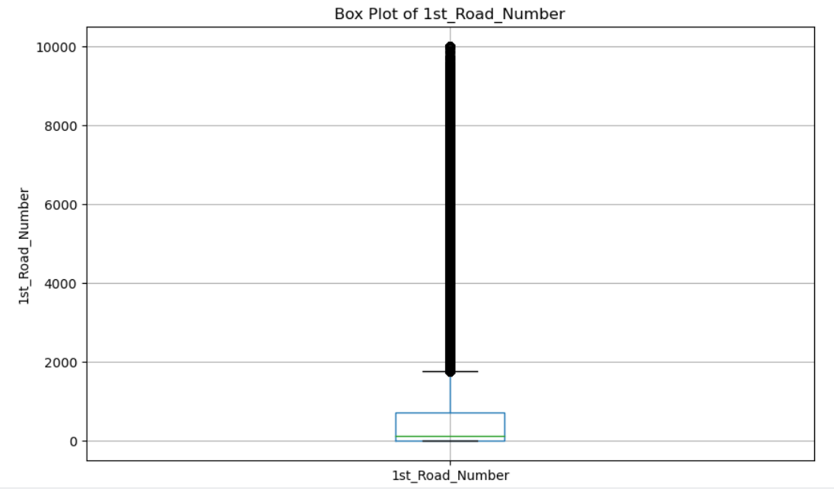
OUTLIERS
# Imputation - fill missing values with mode (for categorical column)
df['1st_Road_Class'].fillna(df['1st_Road_Class'].mode()[0], inplace=True)
df.to_csv('processed_dataset.csv', index=False)
print(df['1st_Road_Class'])

Slide 9
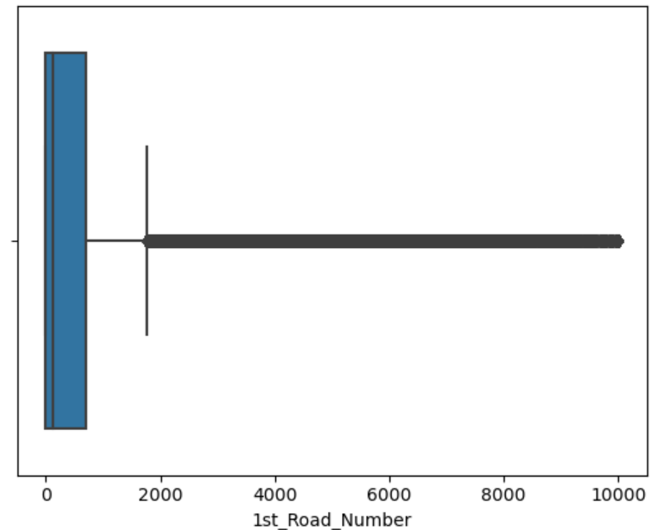
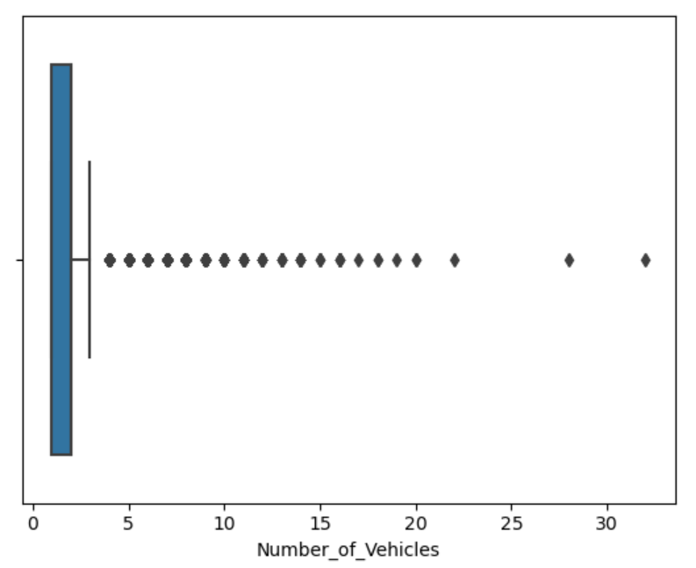
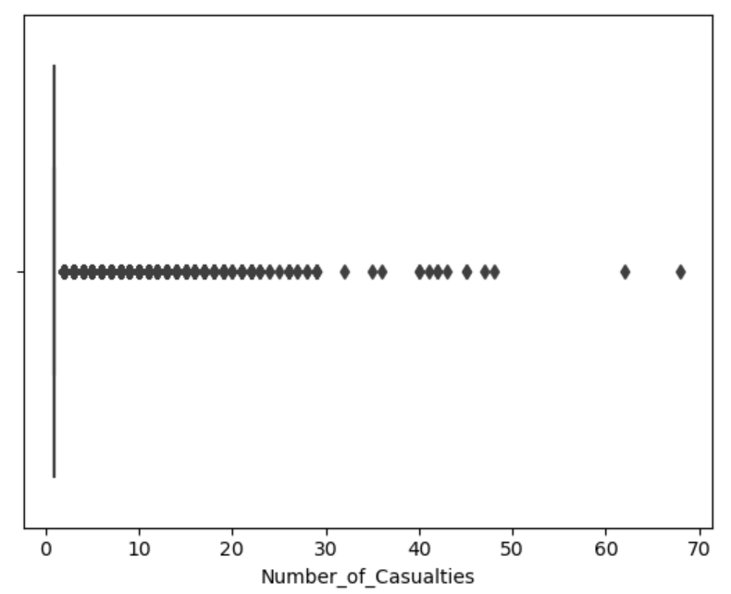
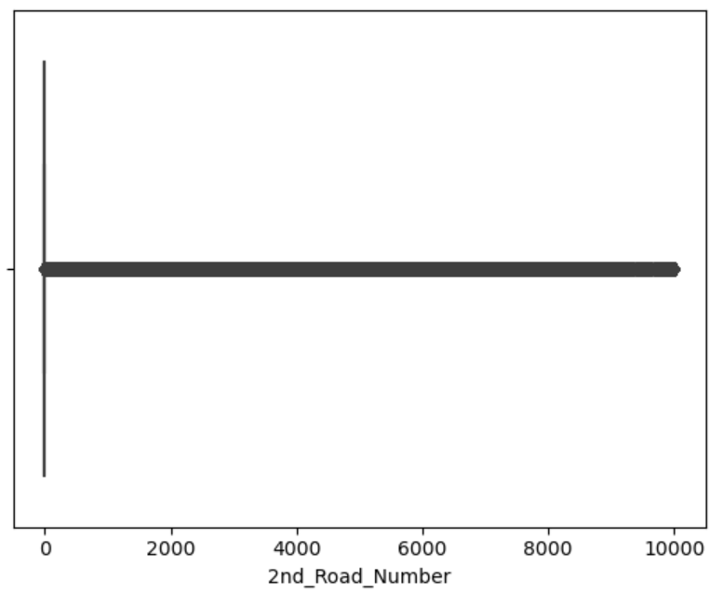
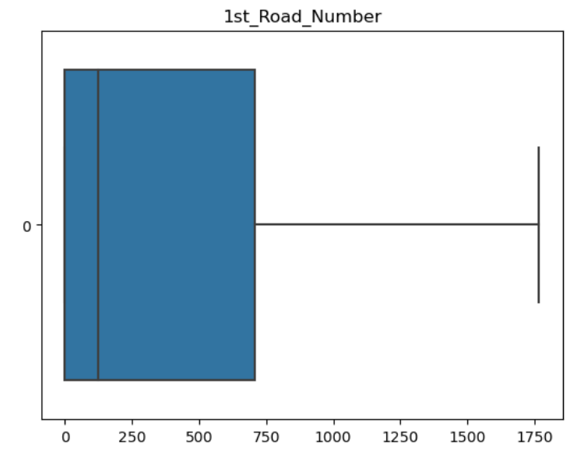
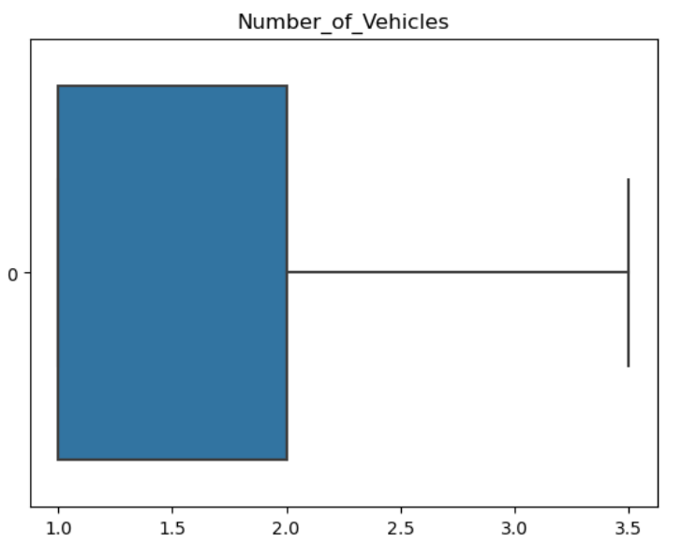
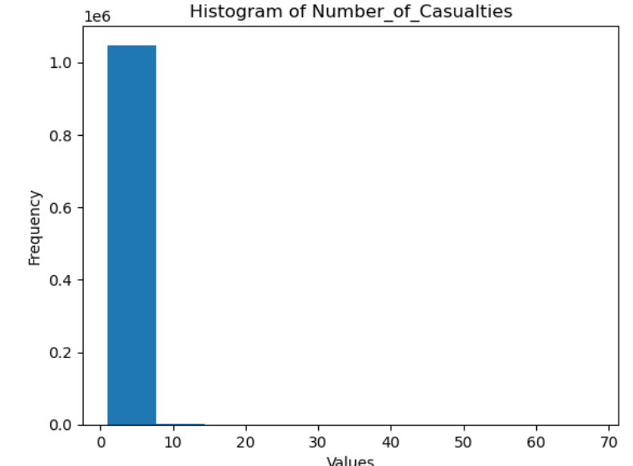
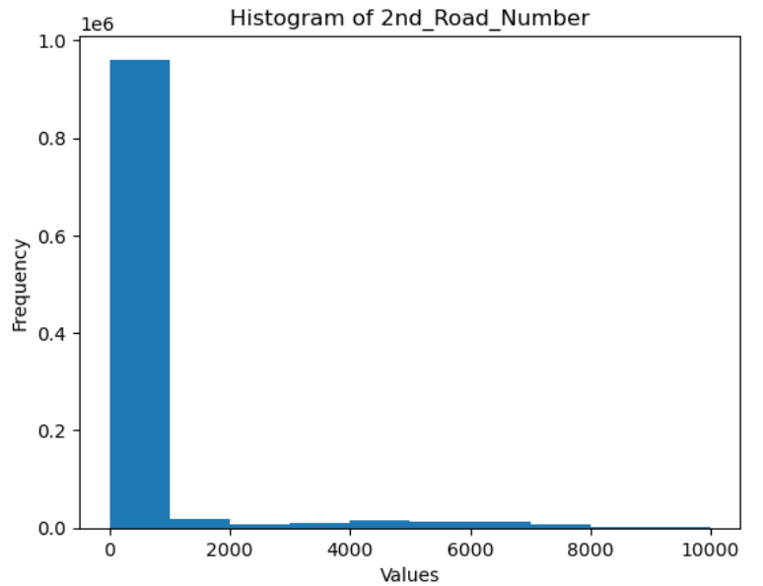

Slide 10
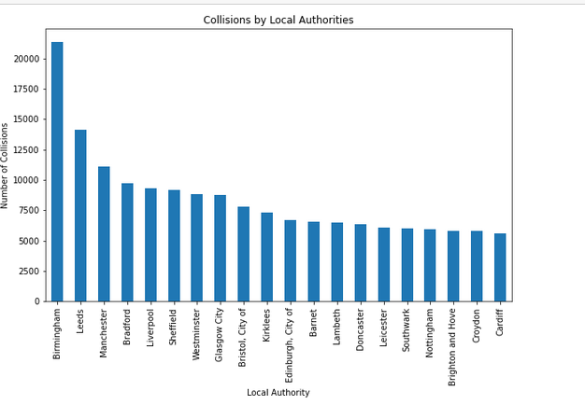
Exploratory Analysis and Visualization
1. Local Authority Analysis

Slide 11
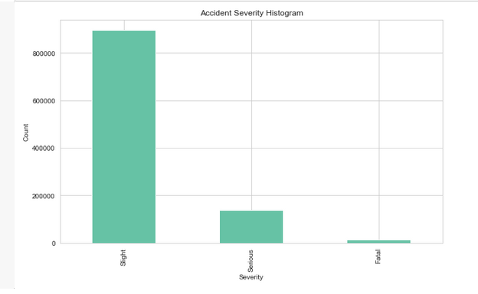
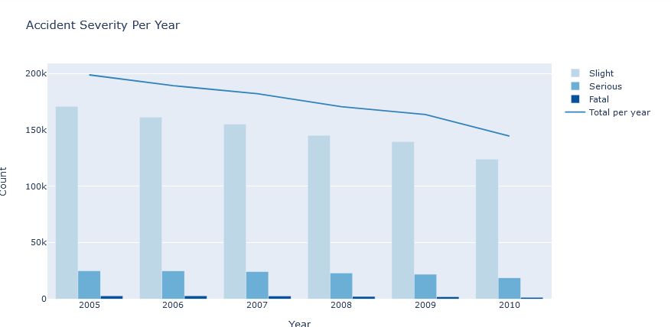
Exploratory Analysis and Visualization
2. Analyse Accident Severity

Slide 12
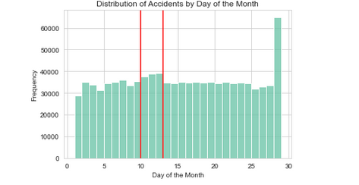
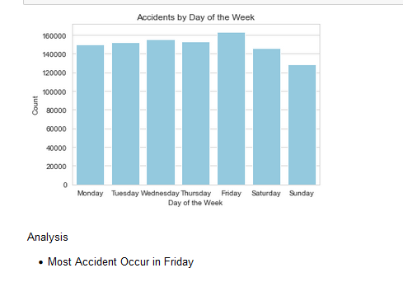
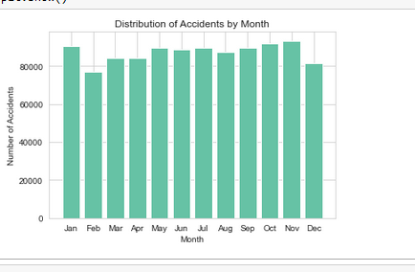
ANAYZE DATE AND TIME
Most accidents occurs between dates 10 - 13 of the month, on first Half of the month and Second Half of the month number of accidents gets down.
Accident occurrence trend looks similar throughout the year
Most Accidents tends and proven to occur on Friday

Slide 13
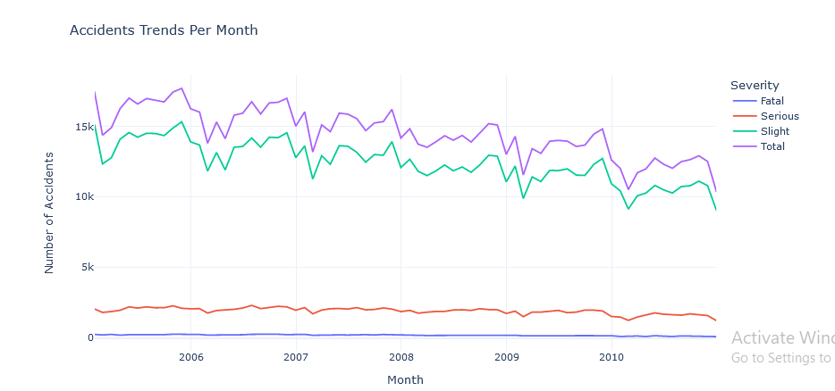
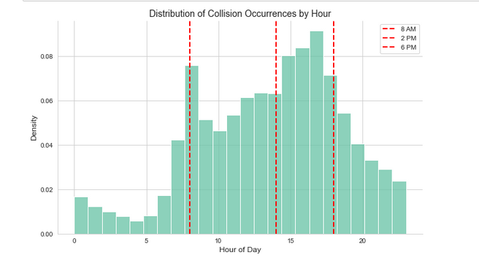
Under which circumstances do accidents happen?

Slide 14
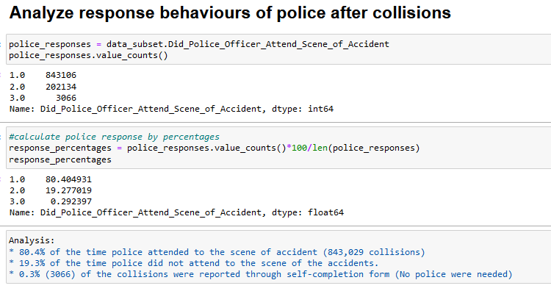
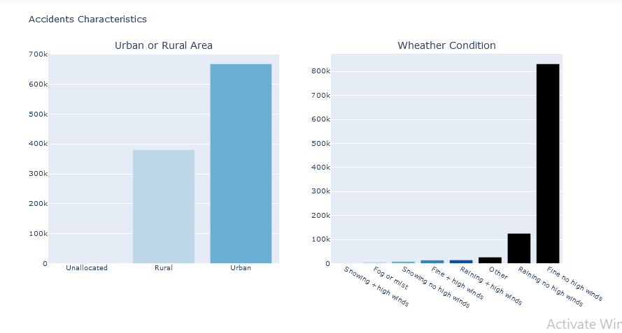
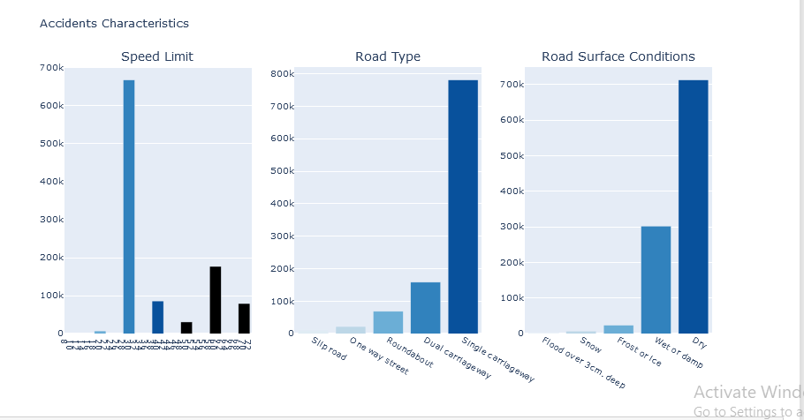

Slide 15
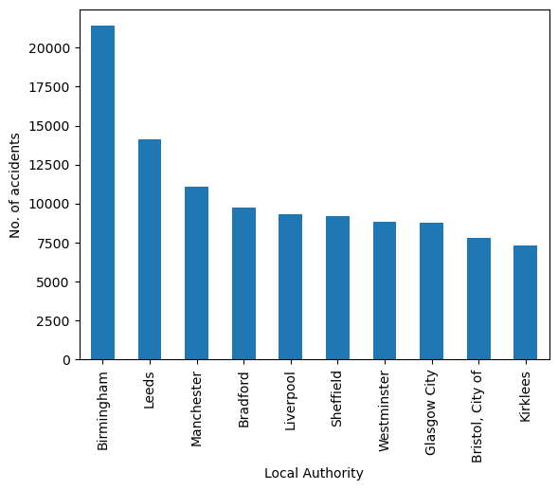
No. of accidents per Local_Authority
Taking the local authority into consideration, Birmingham (21,384) recorded the highest number of accidents
This was followed by Leeds (14,128) and Manchester(11,075)

Slide 16
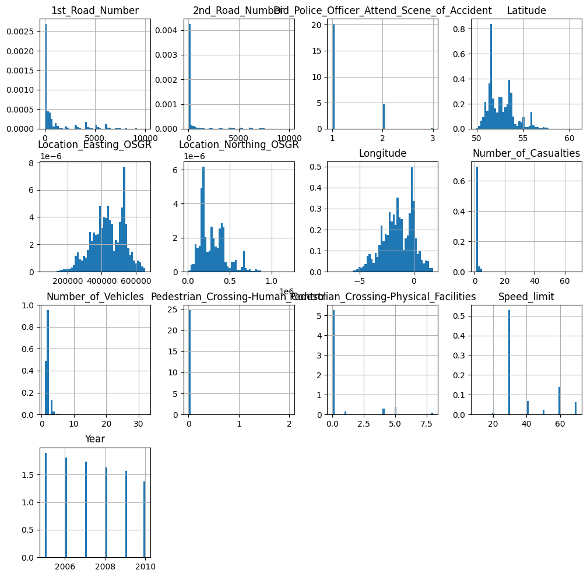
OBSERVATIONS ON HISTOGRAMS

Slide 17
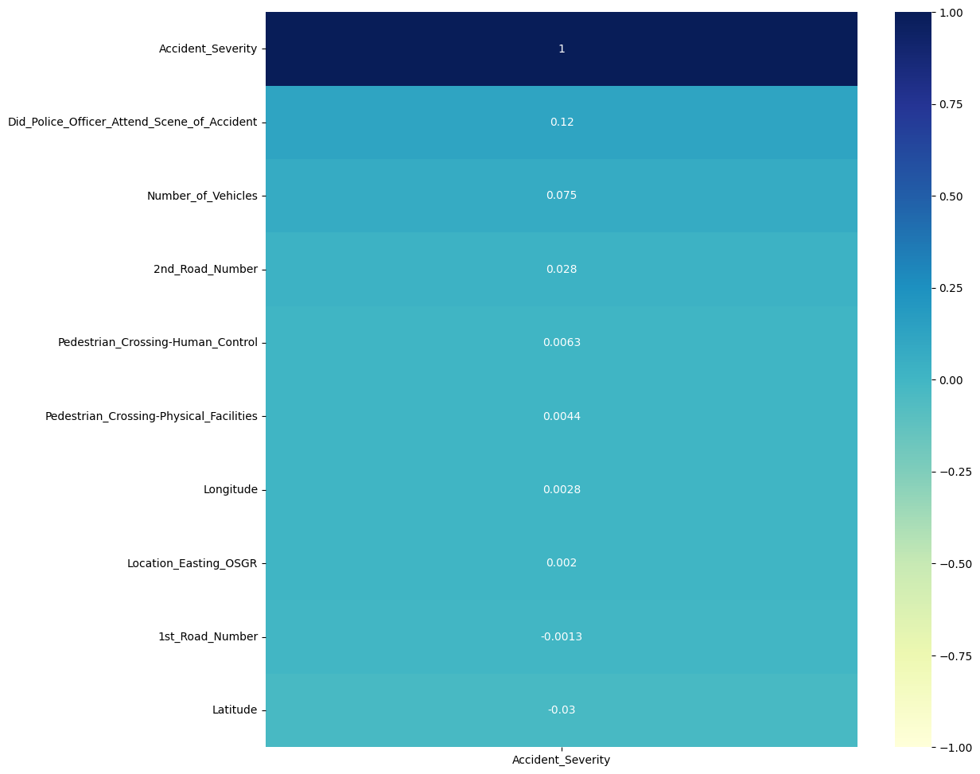
Correlation with target variable
The plot depicts the correlation heatmap of independent features with the target variable

Slide 18
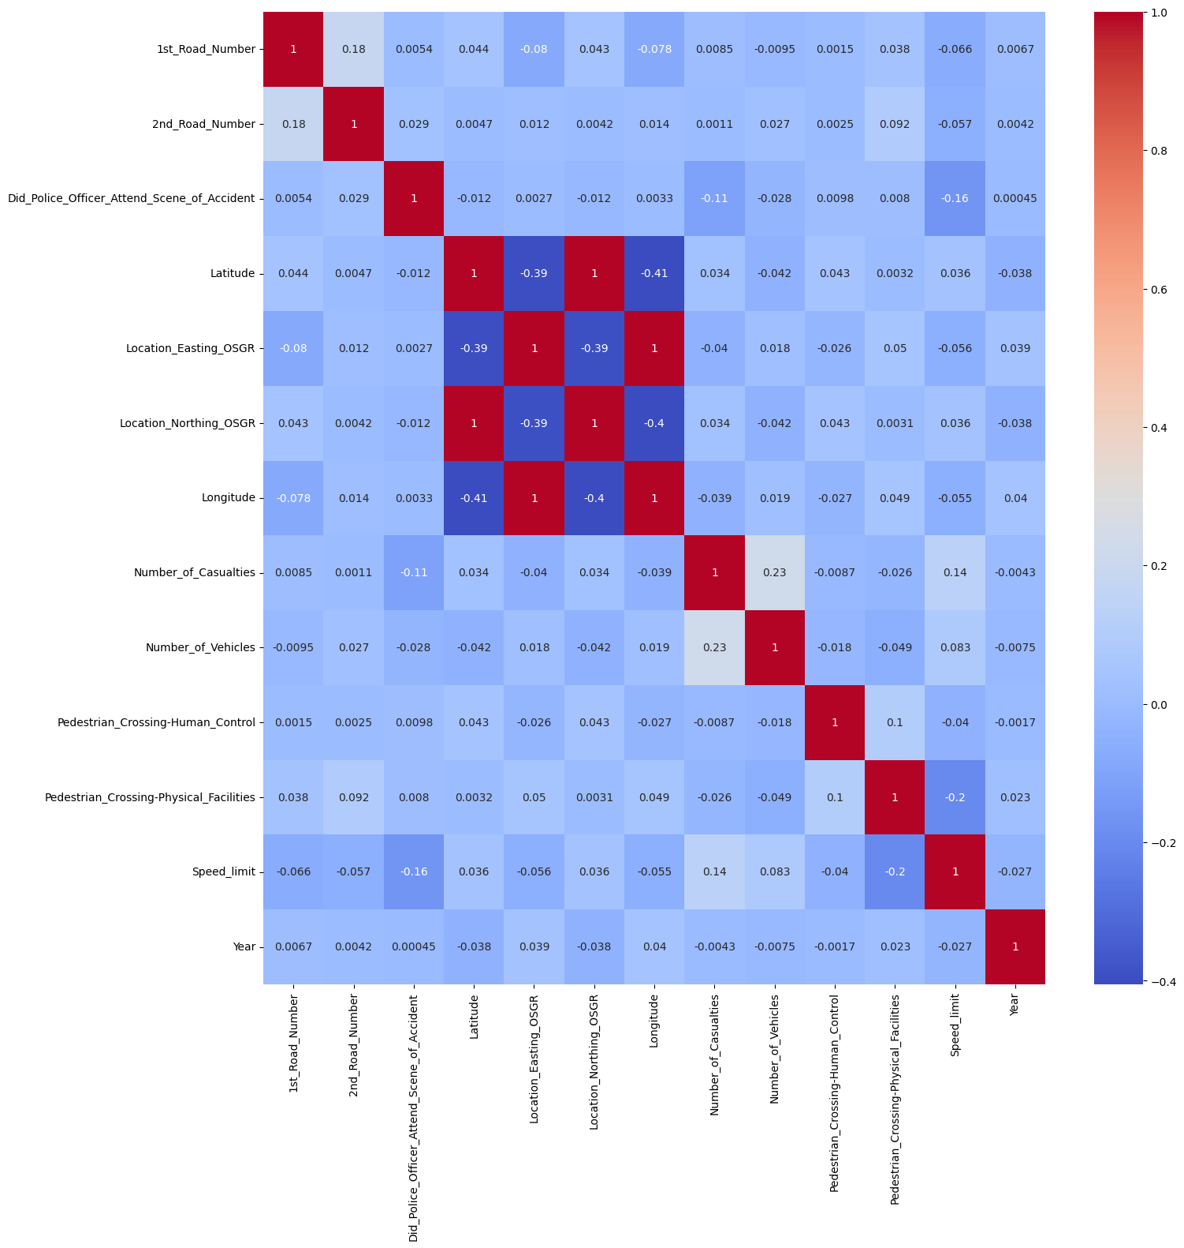
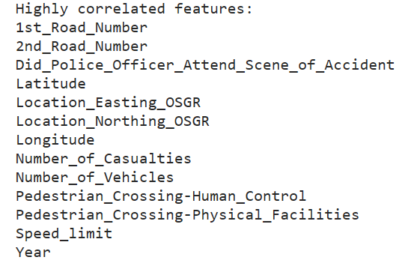
Correlation heatmap

Slide 19
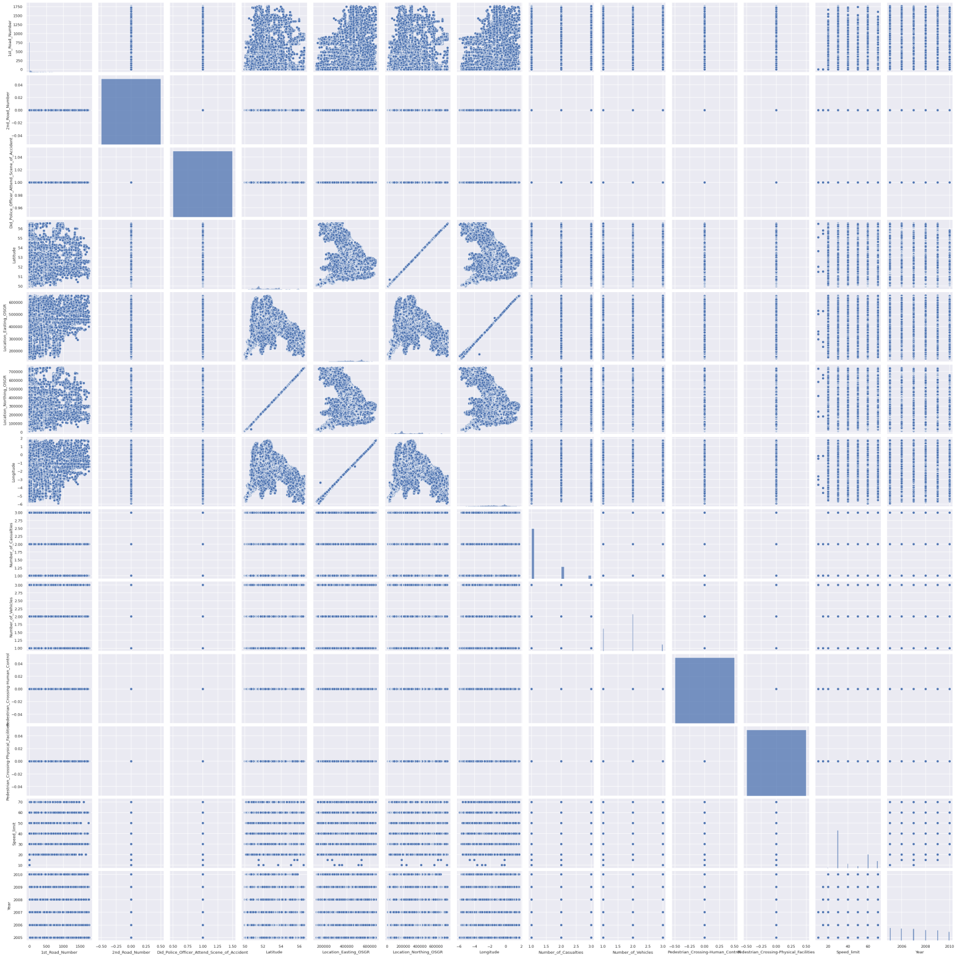
Pair plot matrix

Slide 20
OVERVIEW OF HYPOTHESIS TESTING
Hypothesis testing is a statistical technique used to make inferences and draw conclusions about population parameters based on sample data.
It involves formulating two competing hypotheses, the null hypothesis (H0) and the alternative hypothesis (Ha), and then analyzing the data to determine which hypothesis is supported by the evidence.
Hypothesis testing is essential in data science as it enables us to draw conclusions, make informed decisions, assess relationships
It forms the basis for evidence-based decision-making and contributes to the credibility and reliability of data-driven insights

Slide 21
PURPOSE OF HYPOTHESIS TESTING IN THIS PROJECT.
GOALS OF TESTING
By conducting hypothesis tests, we aim to make evidence-based conclusions and draw inferences about the relationships, effects, or differences between variables in our dataset.
NEED OF DOING
It serves as a crucial tool for drawing meaningful conclusions and generating valuable insights from the available data.
In This project, the purpose of hypothesis testing is to examine and investigate specific claims or hypotheses related to the research question or problem at hand.
PURPOSE OF THIS
Validation of Research Hypotheses
Identification of Significant Relationships or Effects
Evidence-based Decision-making
Quantifying Uncertainty and Confidence

Slide 22
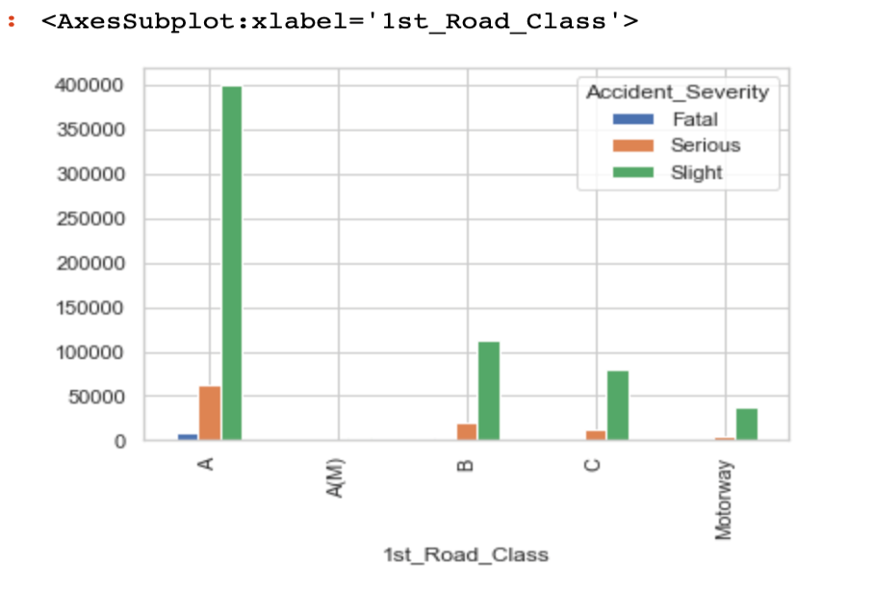
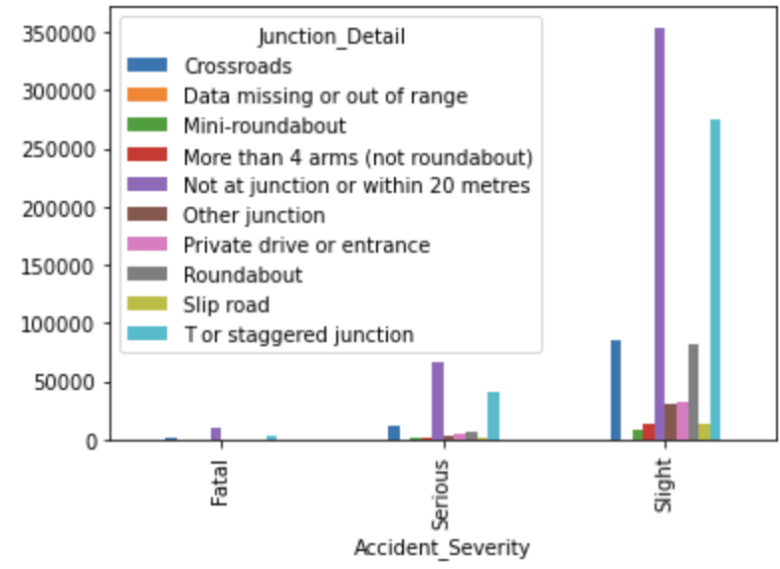
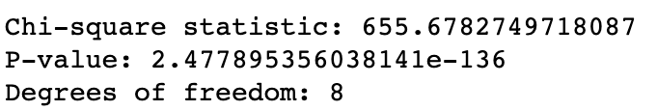

TEST FINDINGS
CHI SQUARE TEST OF ACCIDENT SEVERITY WITH MULTIPLE VARIABLES:-

Slide 23
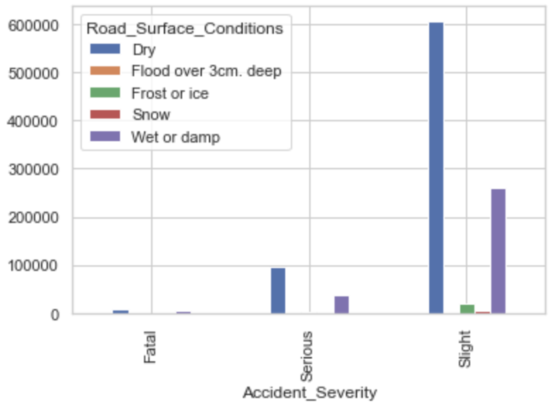
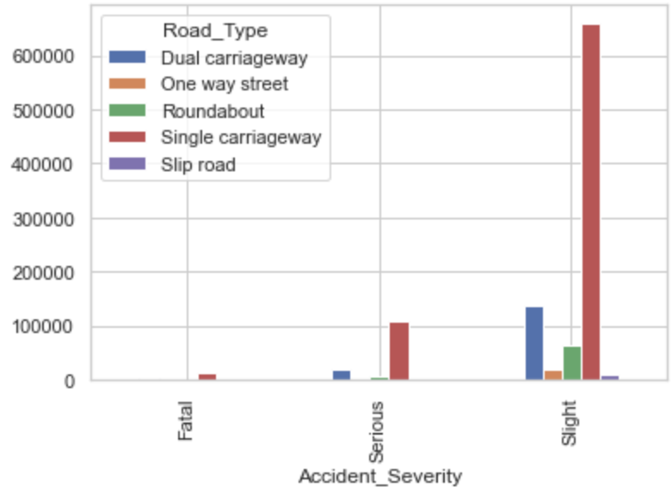
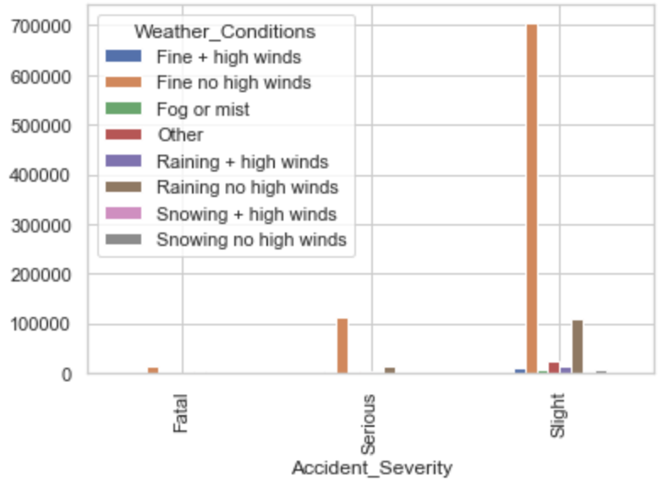
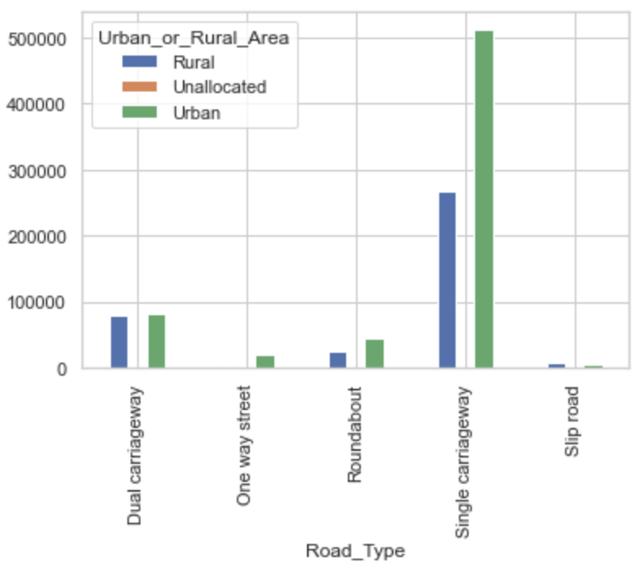
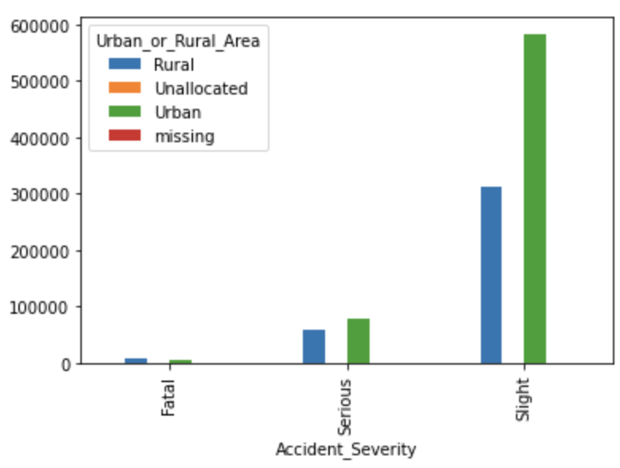
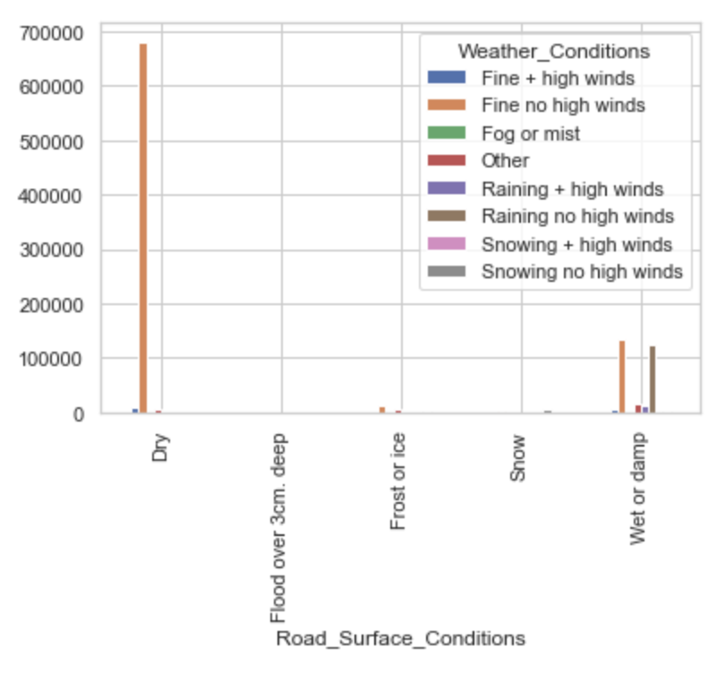
ACCIDENT SEVERITY AND URBAN AND RURAL ROADS

Slide 24
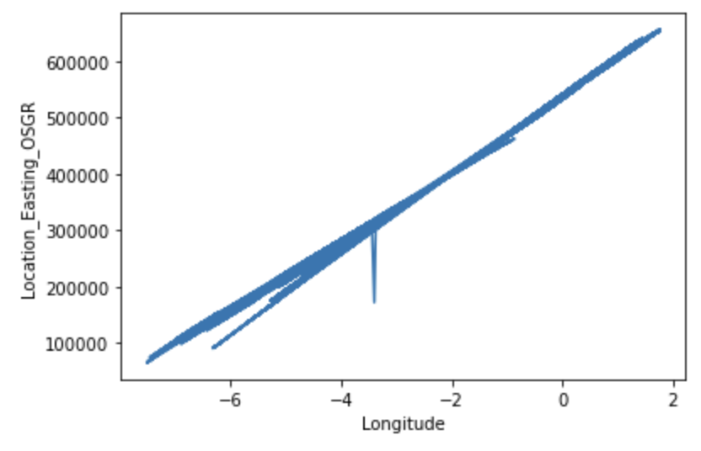
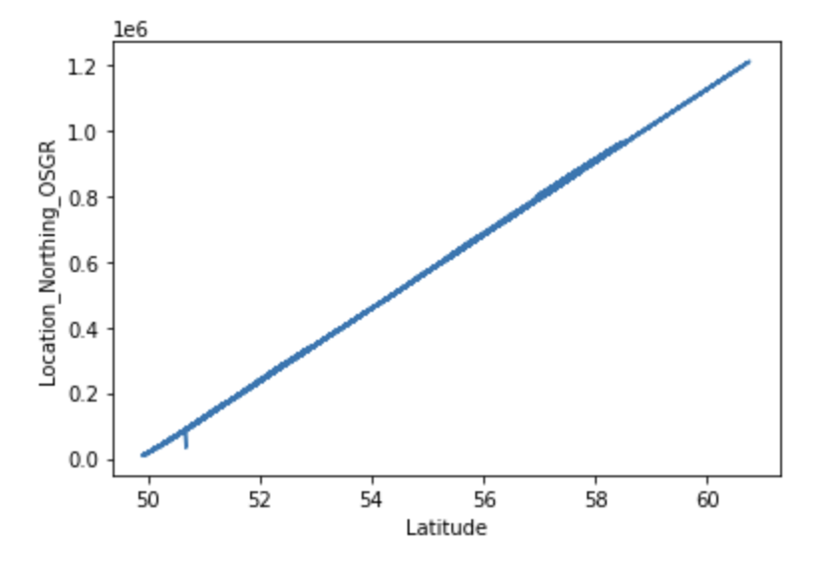
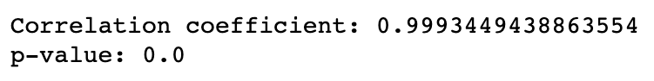
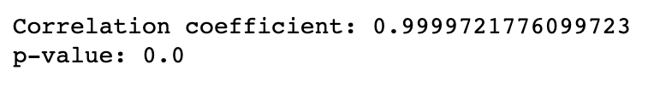
PEARSON CORRELATION BETWEEN LONGITUDE AND LOCATION_EASTING_OSGR
PEARSON CORRELATION BETWEEN LATITUDE AND LOCATION NORTHING OSGR

Slide 25
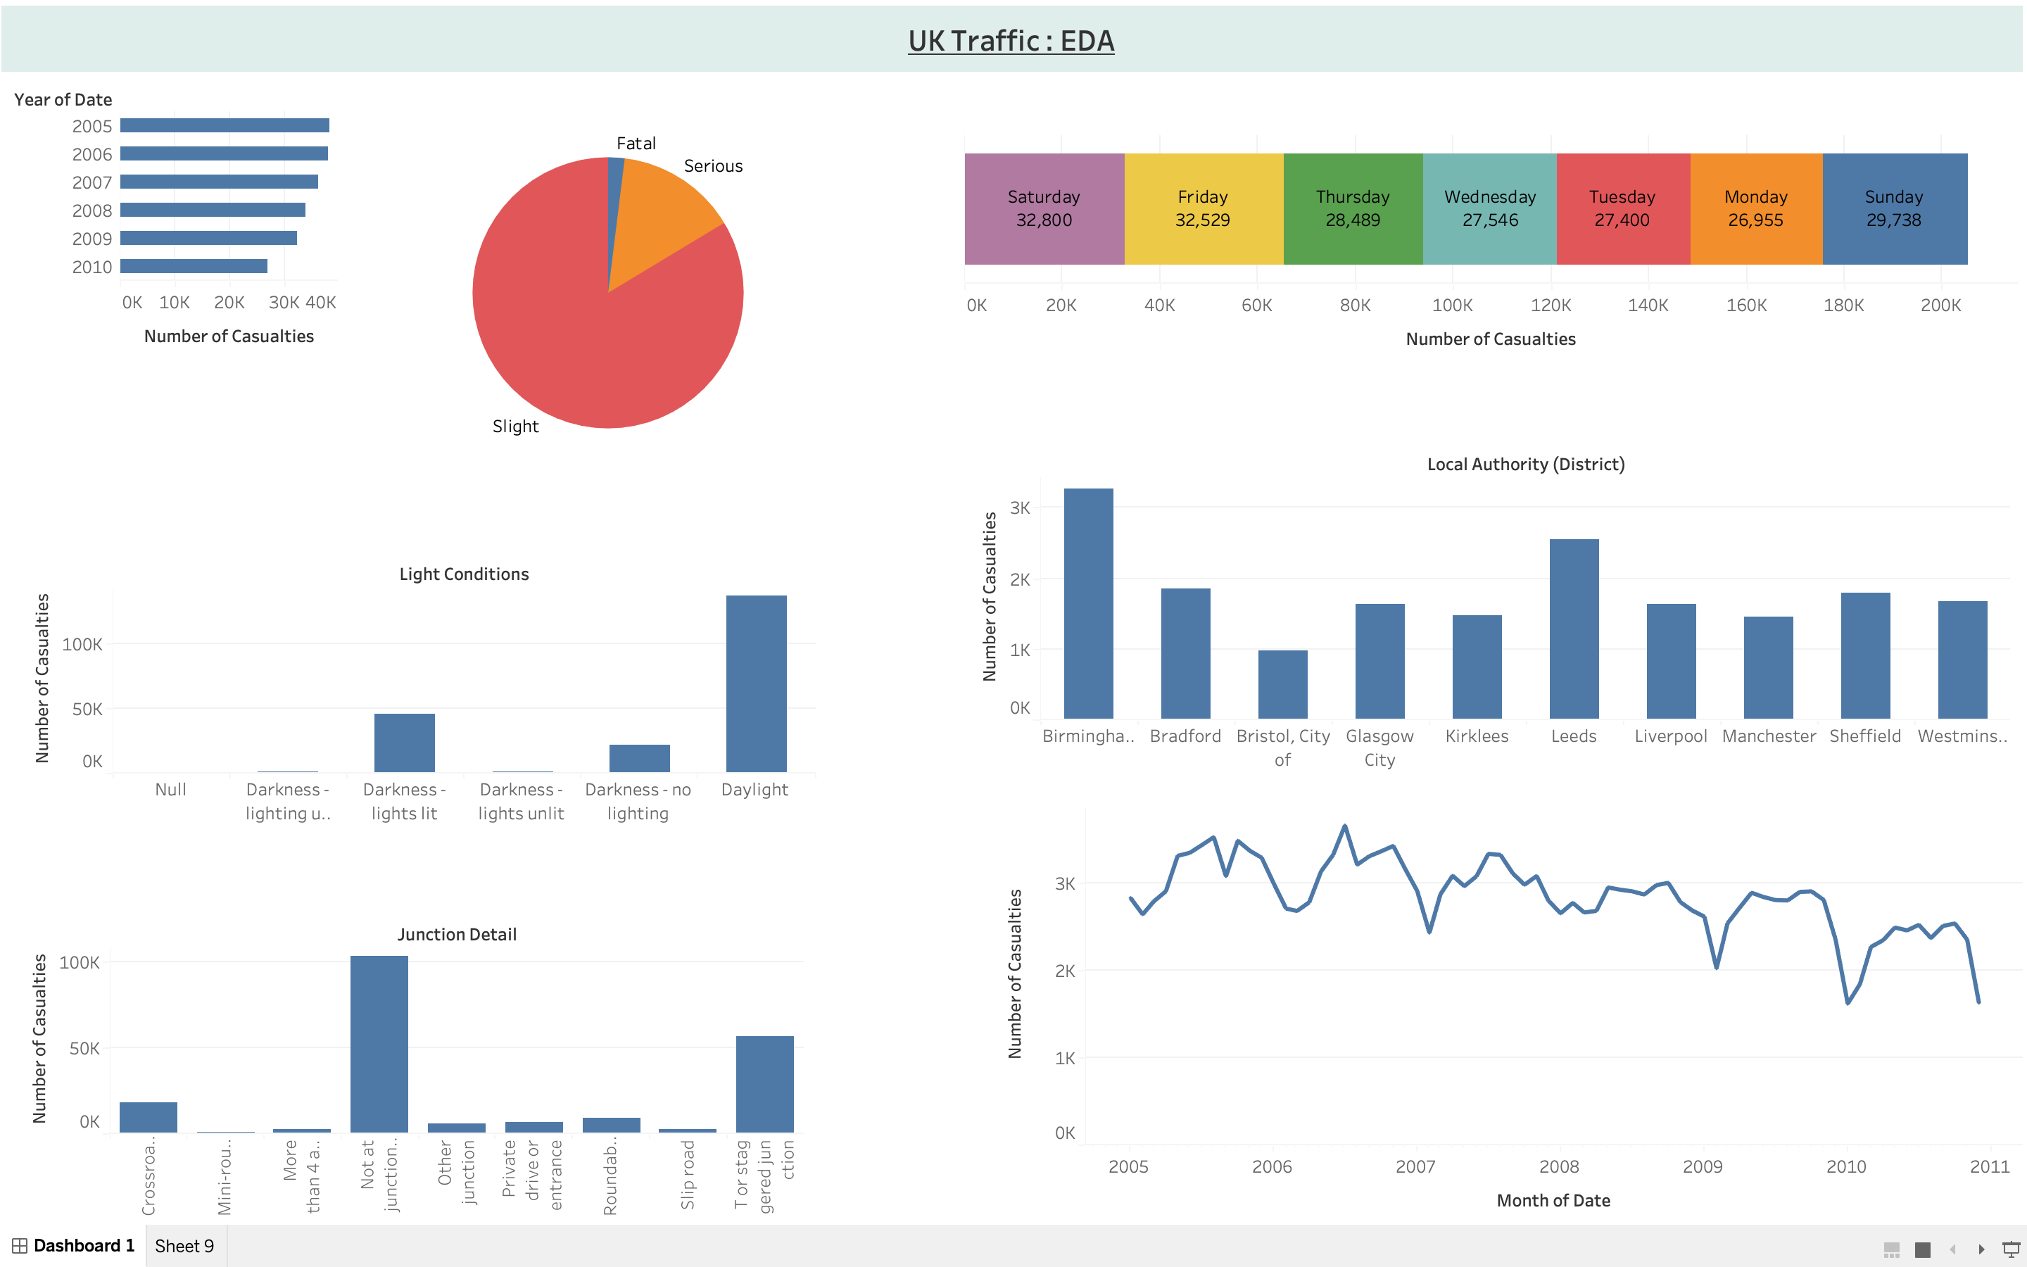
EDA WITH TABLEAU
Observations
Number of Accidents decreasing year on year from 38K to 27K
Most number of Accidents happens on a Friday
Birmingham is the District with highest number of accidents
There is no specific effect of lighting on the number of accidents
Maximum number of accidents have taken place in the month of November
Considerable amount of accidents happen at T point

Slide 26
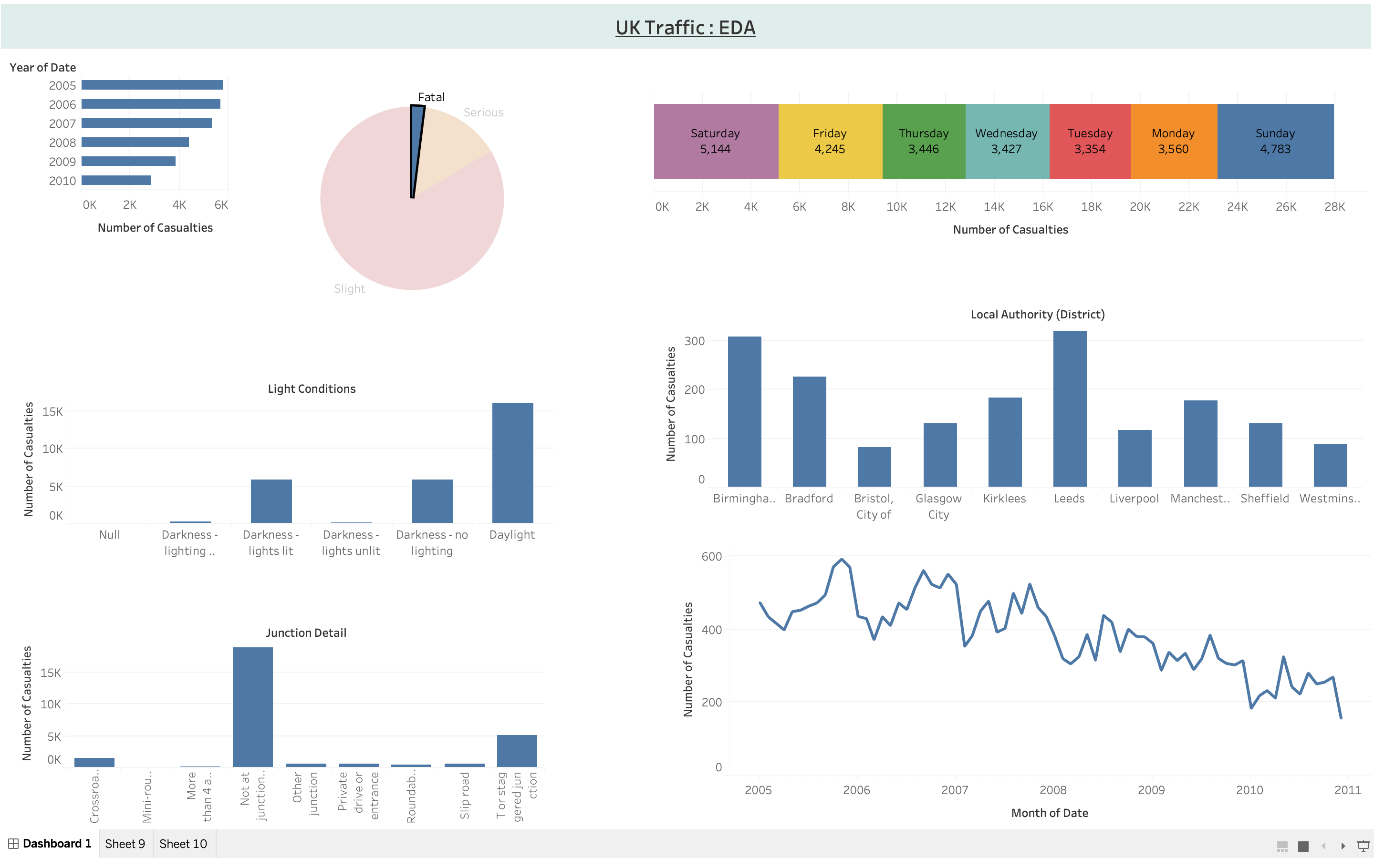
EDA WITH TABLEAU
Observations(Fatal accidents)
Number of Fatalities decreasing year on year from 5796 to 2855
Most number of Fatal Accidents happens on a Saturday followed by Sunday. One reason could be drunk driving over weekends
Leeds is the District with highest number of fatal accidents, reason could be poor medical infrastructure
Number of fatal accident has a bigger share when there is no lighting
Top 3 districts where accidents have happend due to darkness are East Riding of Y0rkshire(1045), Herefodshire((902) and Aberdeenshire((902). Proper Insrastructe development required here.
Although the no of casualties in Urban Area is 60% bu the fatal rate of rural area is 71%

Slide 27
Exploring different Machine Learning Models
NORMAL DATASET!
S.no | ML Technique | Why did we choose this technique | Challenges faced in using this | Accuracy | Precision | Recall
1 | Logistic Regression | It uses mathematics to find relationships between 2 data factors | Because of high dimensional datasets, it lead to model being overfit on the training set | 71% | 50% | 100%
2 | Random Forest | Suits best for classification problems | Final execution of model took too much time. Random forests exhibit real-time prediction but that is slow in nature. They are also difficult to implement and have a complex algorithm. | 85% | 77% | 85%
3 | Support Vector Machine | Chosen because it is used for classifications as well as a regression problem | Code was able to cover only 50% of data, not giving an output and making application not allow to proceed (hang) | - | - | -
4 | Decision Tree | Can handle categorical and numerical variable • Automatic feature selection, helps in identifying relevant variables and simplifying the analysis process • Can handle Interactions and complex decision boundaries • Can handle missing values without imputation • less affected by outlier | Challenges:-overfitting, computationally expensive, more difficult to identify Important features, biases to the majority class | 75% | 76% | 75%

Slide 28
Exploring different Machine Learning Models
NORMAL DATASET!
S.No | ML Technique | Why did we choose this technique | Challenges faced in using this | Accuracy | Precision | Recall
5 | Naïve bayes Classifier | Naive Bayes is better suited for categorical input variables than numerical variables. | As the training data had a different frequency distribution compared to the test set, the Naive Bayes classifier performed poorly. | 70% | 68% | 72%
6 | Adaboost | Works well with Classification problem. These are models that achieve accuracy just above random chance on a classification problem | None | 85% | 79% | 85%

Slide 29
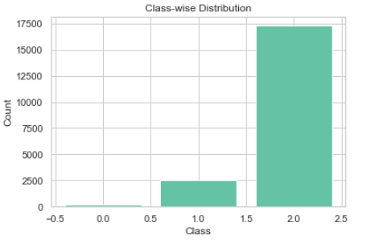
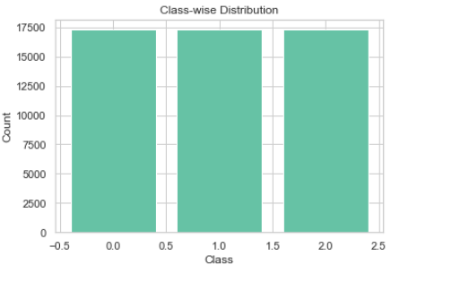
Before And After Balancing the Data Set

Slide 30
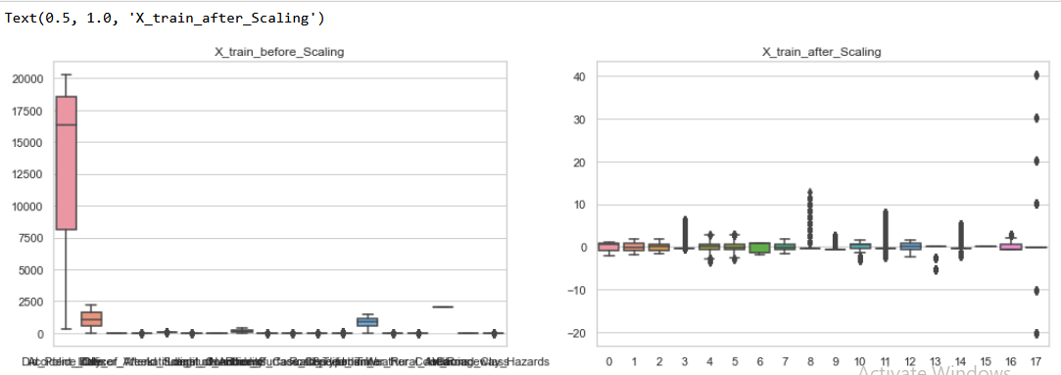
Feature Scaling

Slide 31
AFTER BALANCING THE DATA WITH UNDER SAMPLING METHOD
S.no | ML Technique | Accuracy | Precision | Recall | F1 |  | Parameter Tuning
1 | Logistic Regression | 0.47758620689655173 | 0.47158863038134163 | 0.47758620689655173 | 0.4699197114390965 | 0.582047726097777 | Best score: 0.47965424553659847 Best Parameters: {'C': 0.1, 'penalty': 'l2'}
2 | Random Forest | 0.47758620689655173 | 0.47205009044150287 | 0.47758620689655173 | 0.47336555409772574 | 0.6668088441699128 | Best score: 0.5085799168152109 Best parameters: {'max_depth': 10, 'n_estimators': 100}
3 | Support Vector Machine | 0.46774193548387094 | 0.49227916647271486 | 0.46774193548387094 | 0.47471987211389094 | 0.66390 | Best Score: 0.47560988031576273 Best Parameters: {'C': 0.1, 'gamma': 'auto', 'kernel': 'rbf'}
4 | Decision Tree | 0.4825268817204301 | 0.5212656280091785 | 0.4825268817204301 | 0.4796651694569211 | 0.61929 | Best score: 0.48939195880372355 Best Hyperp arameters: {'criterion': 'gini', 'max_depth': 5, 'min_samples_leaf': 1, 'min_samples_split': 5}
5 | Naïve bayes Classifier | 0.45564516129032256 | 0.48382428629129387 | 0.45564516129032256 | 0.4577765106265054 | 0.5453054854096522 | Best Score: 0.4735936394759924 Best Parameters: {'var_smoothing': 1e-09}
6 | Adaboost | 0.48758620689655174 | 0.4787792693670137 | 0.48758620689655174 | 0.47710792073737346 | 0.5590965060079266 | Best score: 0.5223733129615483 Best Parameters: {'base_estimator__max_depth': 2, 'learning_rate': 0.1, 'n_estimators': 100}

Slide 32
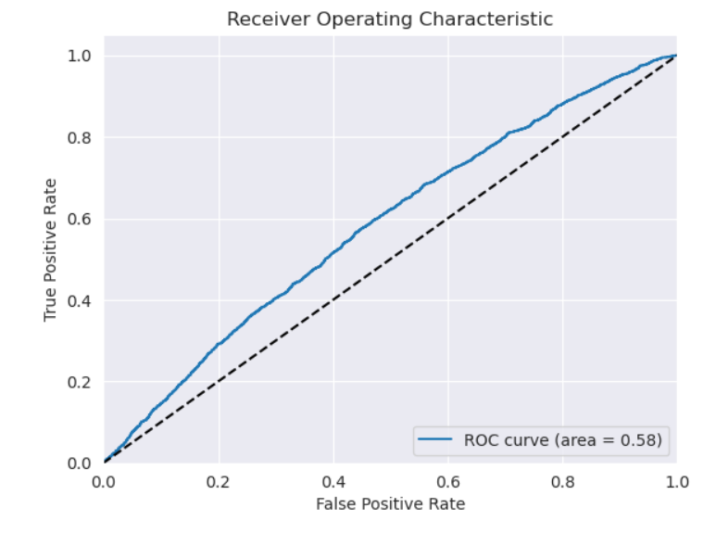
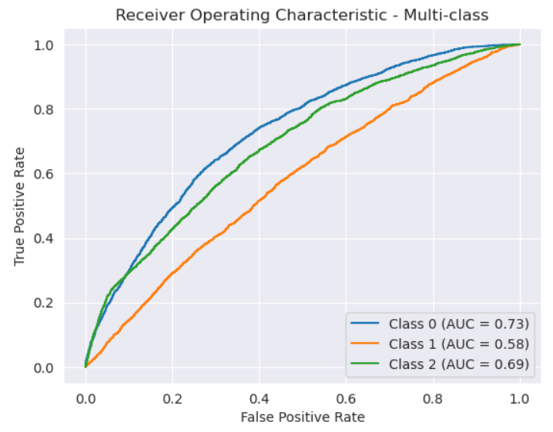
LOGISTIC REGRESSION

Slide 33
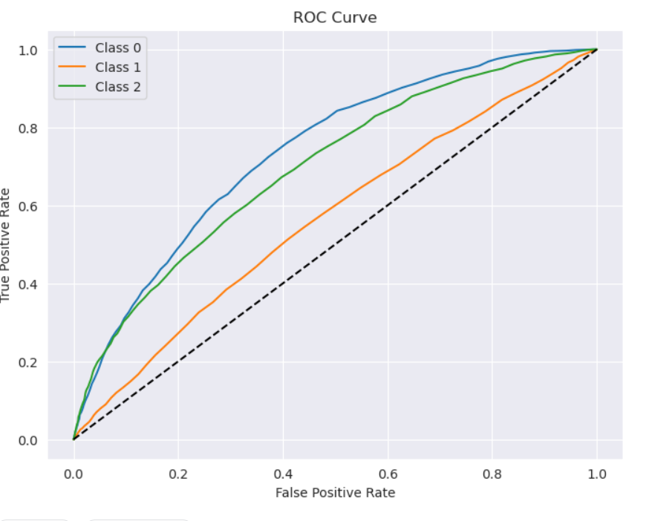
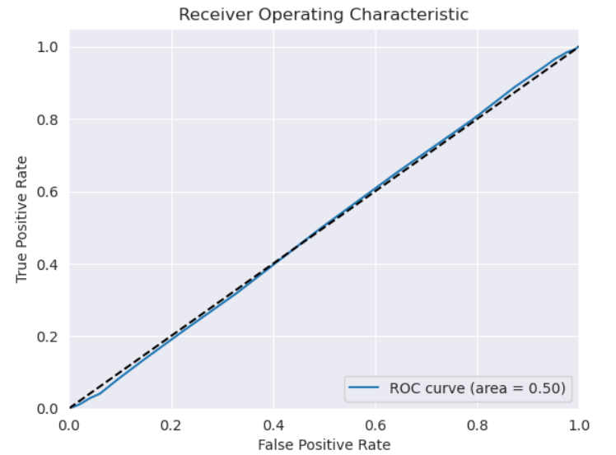
RANDOM FOREST

Slide 34
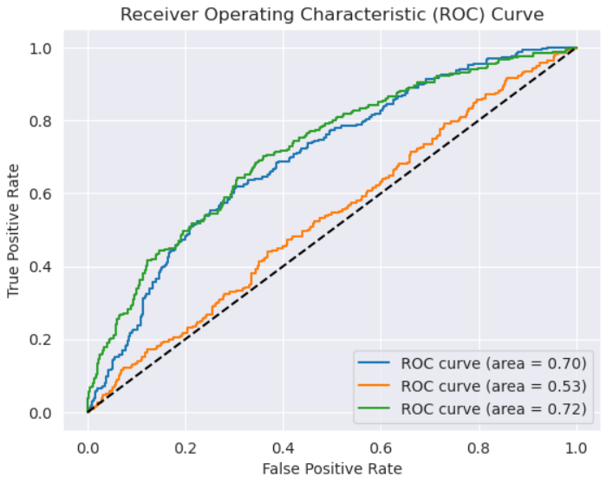
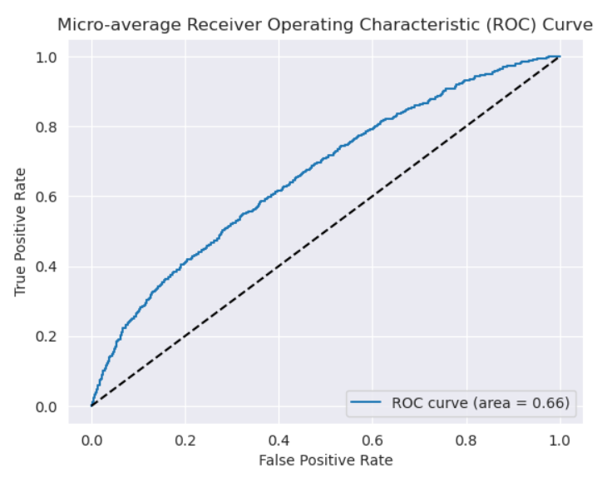
SUPPORT VECTOR MACHINE (SVM)

Slide 35

DECISION TREE

Slide 36


NAÏVE BAYES CLASSIFIER

Slide 37


ADABOOST

Slide 38
AFTER BALANCING THE DATA WITH OVER SAMPLING METHOD
S.no | ML Technique | Accuracy | Precision | Recall | F1 | AUC | Parameter Tuning
1 | Logistic Regression | 0.6327356853672643 | 0.6115019213644727 | 0.6327356853672643 | 0.6105035204491968 | 0.6891235894235126 | Best score: 0.6361555058758208 Best Parameters: {'C': 0.1, 'penalty': 'l2'}
2 | Random Forest | 0.9291497975708503 | 0.9288122033817434 | 0.9291497975708503 | 0.9288274443943897 | 0.9851353504886262 | 0.9205649648206432 Best parameters: {'max_depth': None, 'n_estimators': 150}
3 | Support Vector Machine | 0.7889917100443417 | 0.7916971862506538 | 0.7889917100443417 | 0.7785624341692381 | 0.94724262 | Best Score: 0.47031576273 Best Parameters: {'C': 0.1, 'kernel': 'rbf'}
4 | Decision Tree | 0.8757470599575863 | 0.8757935428457352 | 0.8757470599575863 | 0.8753623111158045 | 0.91298 | Best score: 0.8621213397752608 Best Hyperparameters: {'criterion': 'entropy', 'max_depth': None, 'min_samples_leaf': 1, 'min_samples_split': 2}
5 | Naïve bayes Classifier | 0.6235781762097552 | 0.6190292805414122 | 0.6235781762097552 | 0.6012715560222835 | 0.6960191450470874 | Best Score: 0.6211890574125629 Best Parameters: {'var_smoothing': 1e-09}
6 | Adaboost | 0.7026219394640447 | 0.692775095512105 | 0.7026219394640447 | 0.6944251490777927 | 0.847833 | Best score: 0.7784447164544968 Best Parameters: {'base_estimator__max_depth': 3, 'learning_rate': 0.1, 'n_estimators': 200}

Slide 39


LOGISTIC REGRESSION

Slide 40


RANDOM FOREST

Slide 41


SVM (SUPPORT VECTOR MACHINE)

Slide 42

DECISION TREE

Slide 43


Naïve Byes

Slide 44


ADABOOST

Slide 45
Conclusion & Recommendation
After thorough analysis and evaluation of multiple model like Decision Tree, Support Vector Machine (SVM), Logistic Regression, NaiveBayers, AdaBoost and Random Forest.
We have found that the Random Forest model outperform the others on our dataset. We evaluated the mode based on various evaluation metric such as Accuracy, Precision, Recall and F1 score.
Random Forest demonstrated the best overall performance, consistently delivering high accuracy and precision and effectively capturing both positive and negative cases.
Additionally, the area under the receiver operating characteristic curve (AUC-ROC) was also high, indicating the model’s excellent ability to discriminate between different classes.

Slide 46
Conclusion & Recommendation
To ensure the Random Forest Model’s optimal performance, we conducted Hyperparametre tuning using GridSearchCV, resulting in the best parameter configuration with a score of 92.54%.
This process improved the model’s ability to generalize and make more accurate predictions on unseen data.
Considering al the evaluation results, we conclude that the Random Forest model is the most suitable and reliable choice for our dataset.
It provides a robust solution for the classification task and is well-equipped to handle the imbalanced nature of our data, making it an Ideal choice for further deployment and real-world applications.

Slide 47
THANK YOU
- GROUP D

